Slide 1
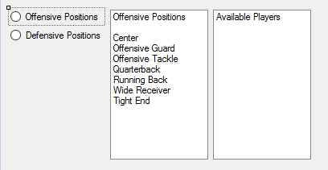
Category Selection Method
Offensive and Defensive categories are displayed. Categories stored in lists and displayed.
User selects one of the categories to display available players.

Slide 2
Category Selection
Offense Positions
Defense Positions
Center
Offensive Guard
Offensive Tackle
Quarterback
Running Back
Wide Receiver
Tight End
Defensive Tackle
Defensive End
Middle Linebacker
Outside Linebacker
Cornerback
Safety

Slide 3
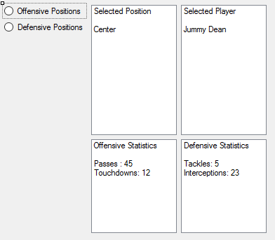
Athlete Selection Method
Within category, user selects Athlete to display their statistics. Athletes stats retrieved from database or other similar java feature.
If Athlete is acceptable, user adds to their team list.

Slide 4
Athlete Selection
Offensive Stats
Defensive Stats
Passing
Rushing
Receiving
Kick Returns
Punt Returns
Touchdowns
Interceptions
Sacks

Slide 5
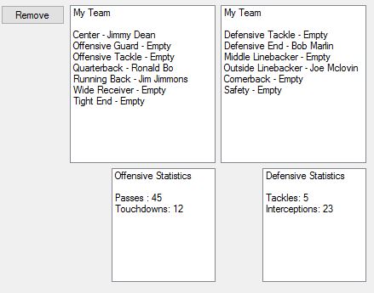
User Team Management
User adds selected athlete to team. Chosen athletes stored in list or array.
User can view list of selected athletes. Display names of chosen athletes.
User can remove an athlete from their list. Remove selected athlete from the list.

Slide 6
User’s Team
Selections
Commands
User has a list of positions for their team.
Each position is marked with either the chosen athletes name or an empty marker if no athlete is chosen.
User can view athletes on team, including chosen position.
User can remove a selection, returning it to the main list.

